Slide 1
C H A P T E R
1
PLAYERS IN THE SYSTEMS GAME
Notes:
Chapter 1 - Players in the Systems Game
This repository of slides is intended to support the named chapter. The slide repository should be used as follows:
Copy the file to a unique name for your course and unit.
Edit the file by deleting those slides you don’t want to cover, editing other slides as appropriate to your course, and adding slides as desired.
Print the slides to produce transparency masters or print directly to film or present the slides using a computer image projector.
Each slide includes instructor notes. To view those notes in PowerPoint, click-left on the View Menu; then click left on Notes View sub-menu. You may need to scroll down to see the instructor notes.
The instructor notes are also available in hardcopy as the Instructor Guide to Accompany Systems Analysis and Design Methods, 5/ed.

Slide 2
Chapter One Players in the Systems Game
What are information systems, and who are the stakeholders in the information systems game?
What role will you personally play in the development and use of information systems?
Who are information system users? How is the definition changing in a remote computing and Internet-centric world?
What is a systems analyst and why are these individuals the key players in the development and implementation of information systems?
What are systems analysis and design?
Where do systems analysts work?
What modern business and technology trends are affecting information systems development?
What are the career prospects for systems analysts?
If you want to pursue a career as a systems analyst, what knowledge and skills do you need to acquire?
Notes:
Chapter 1 - Players in the Systems Game
No additional notes

Slide 3
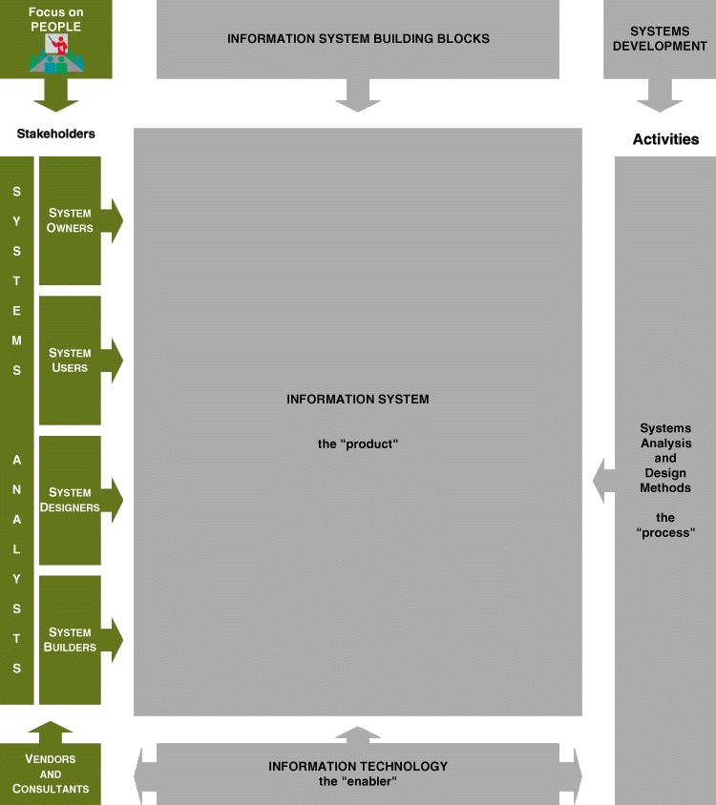
Chapter Map
Notes:
Chapter 1 - Players in the Systems Game
Teaching Notes
This is the first “chapter map” for the book.
Each chapter will include a chapter map that visually maps the chapter to our adaptation of John Zachman’s Framework for Information Systems Architecture.
The complete map will be built over the course of the first three chapters.
Chapter 1 emphasizes the stakeholders column.
Conversion Notes
The only change in the stakeholders column from fourth edition was the addition of the external influence from and the participation of “IT Vendors and Consultants.”

Slide 4
Information Systems & Technology
An information system (IS) is an arrangement of people, data, processes, communications, and information technology that interact to support and improve day-to-day operations in a business, as well as support the problem-solving and decision-making needs of management and users.
Information technology is a contemporary term that describes the combination of computer technology (hardware and software) with telecommunications technology (data, image, and voice networks).
Notes:
Chapter 1 - Players in the Systems Game
Conversion Notes
In previous editions, we tried to distinguish between “information systems” and “computer applications” (the latter being a subset of the former). This created more confusion with students than it was worth.
Some books use the term “computer technology.” We prefer the more contemporary term “information technology” as a superset of computer technology.

Slide 5
Stakeholders: Players in the Systems Game
A stakeholder is any person who has an interest in an existing or new information system. Stakeholders can be technical or nontechnical workers.
For information systems, the stakeholders can be classified as:
System owners
System users
Systems analysts
System designers
System builders
IT vendors and consultants
Notes:
Chapter 1 - Players in the Systems Game
Conversion Notes
The classification scheme (system owners, system users, et al.) was moved up from Chapter 2 in the fourth edition.
Teaching Tips
You might want to remind students that a single individual can play multiple roles in a project. For example:
A person could be both a system owner and system user.
Many systems analysts are also system designers and builders.
It is sometimes useful to identify individuals who might play the various roles in a typical information system.

Slide 6
Information versus Knowledge Workers
Information workers are those workers whose jobs involve the creation, collection, processing, distribution, and use of information.
Knowledge workers are a subset of information workers whose responsibilities are based on a specialized body of knowledge.
Notes:
Chapter 1 - Players in the Systems Game
Teaching Tips
Give examples of information workers and knowledge workers to reinforce the difference.
Footnote – Information workers (sometimes called “white-collar workers”) have outnumbered blue-collar workers since 1957.
Typically a knowledge worker has a degree or credential in some subject area (hence, they are often called “subject area experts”). Examples include engineers, scientists, accountants, lawyers, etc.

Slide 7
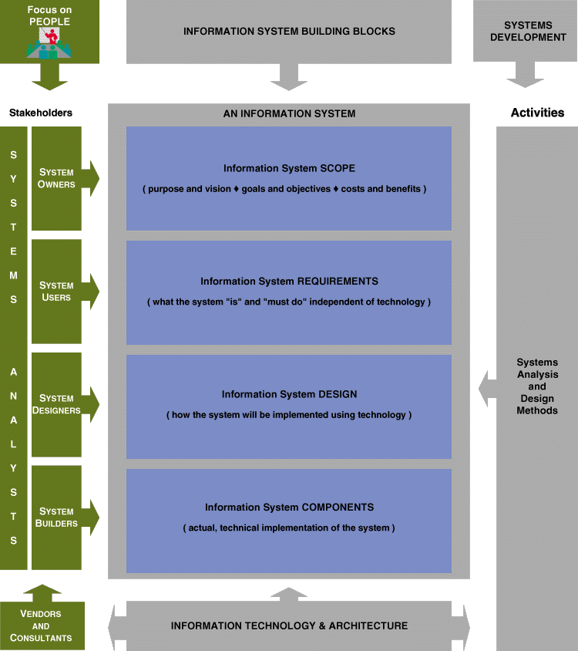
Notes:
Chapter 1 - Players in the Systems Game
Teaching Notes
This is the first “chapter map” for the book.
Each chapter will include a chapter map that visually maps the chapter to our adaptation of John Zachman’s Framework for Information Systems Architecture.
The complete map will be built over the course of the first three chapters.
Chapter 1 emphasizes the stakeholders column.
Conversion Notes
The only change in the stakeholders column from fourth edition was the addition of the external influence from and the participation of “IT Vendors and Consultants.”

Slide 8
System Owners
System owners are the information system’s sponsors and chief advocates. They are usually responsible for funding the project to develop, operate, and maintain the information system.
Notes:
Chapter 1 - Players in the Systems Game
No additional notes

Slide 9
System Users
System users are the people who use or are affected by the information system on a regular basis—capturing, validating, entering, responding to, storing, and exchanging data and information. A common synonym is client. Types include:
Internal users
Clerical and service workers
Technical and professional staff
Supervisors, middle managers, and executive managers
Remote and mobile users (internal but disconnected)
External users
Notes:
Chapter 1 - Players in the Systems Game
Teaching Tip
Update students on the trend of “telecommuting.” Telecommuting falls into our “Remote” users category.
Some students may confuse “remote users” and “external users.” The difference is that remote users work for the organization in question, while external users work for some other organization (or are direct consumers).
The growth of the Web is driving the increase in both remote and external users.

Slide 10
System Designers and System Builders
System designers translate system users’ business requirements and constraints into technical solutions. They design the computer files, databases, inputs, outputs, screens, networks, and programs that will meet the system users’ requirements.
System builders construct the information system components based on the design specifications from the system designers. In many cases, the system designer and builder for a component are one and the same.
Notes:
Chapter 1 - Players in the Systems Game
Teaching Notes
Programmers are typically viewed as system builders, but in fact, they are also system designers since good programmers design the software they build.
In reality, most technical specialists serve in most roles. For instance, database specialists typically design and construct databases.

Slide 11
Systems Analysts
A systems analyst studies the problems and needs of an organization to determine how people, data, processes, communications, and information technology can best accomplish improvements for the business. When information technology is used, the analyst is responsible for:
The efficient capture of data from its business source,
The flow of that data to the computer,
The processing and storage of that data by the computer, and
The flow of useful and timely information back to the business and its people.
Notes:
Chapter 1 - Players in the Systems Game
Teaching Notes
Actually, we offered two definitions in the chapter. First, we characterized the systems analyst as a “facilitator” of the other stakeholders’ participation in systems development. Then we offered the more precise definition in this slide.

Slide 12
Variations on the Systems Analysts Title
A business analyst is a systems analyst that specializes in business problem analysis and technology-independent requirements analysis.
A programmer/analyst (or analyst/programmer) includes the responsibilities of both the computer programmer and the systems analyst.
Other synonyms for systems analyst include:
Systems consultant
Systems architect
Systems engineer
Information engineer
Systems integrator
Notes:
Chapter 1 - Players in the Systems Game
Conversion Notes
We dropped “application analyst” and “information analyst” as variations described in the previous edition. It has become much less common.
Teaching Notes
Business analyst is becoming more popular because of the number of end-users and other knowledge workers being assigned to systems analysts roles in organizations.

Slide 13
Problem-Solving Scenarios
True problem situations, either real or anticipated, that require corrective action
Opportunities to improve a situation despite the absence of complaints
Directives to change a situation regardless of whether anyone has complained about the current situation
Notes:
Chapter 1 - Players in the Systems Game
Teaching Tips
It can be useful to present examples of each scenario from the instructor’s personal experiences.
The classification scheme is not mutually exclusive; that is,
a project can be driven by multiple instances and combinations of problems, opportunities, and directives.
a problem might be classified as both a true problem an opportunity, or an opportunity plus directive.

Slide 14
General Problem-Solving Approach
1. Identify the problem.
2. Analyze and understand the problem.
3. Identify solution requirements or expectations.
4. Identify alternative solutions and decide a course of action.
5. Design and implement the “best” solution.
6. Evaluate the results. If the problem is not solved, return to step 1 or 2 as appropriate.
Notes:
Chapter 1 - Players in the Systems Game
Conversion Notes
We replaced the phase-like naming of the problem-solving steps introduced in Chapter 1 of the 4th edition (p. 9). This should prevent some students and instructors from confusing these problem-solving steps with an actual system development life cycle or methodology (introduced in Chapter 3).

Slide 15
Where Systems Analysts Work
In traditional businesses
Working in traditional information services organizations (permanent project teams)
Working in contemporary information services organizations (dynamic project teams)
In outsourcing businesses
Contracted to traditional businesses
In consulting businesses
Contracted to traditional businesses
In application software businesses
Building software products for traditional businesses
Notes:
Chapter 1 - Players in the Systems Game
No additional notes

Slide 16
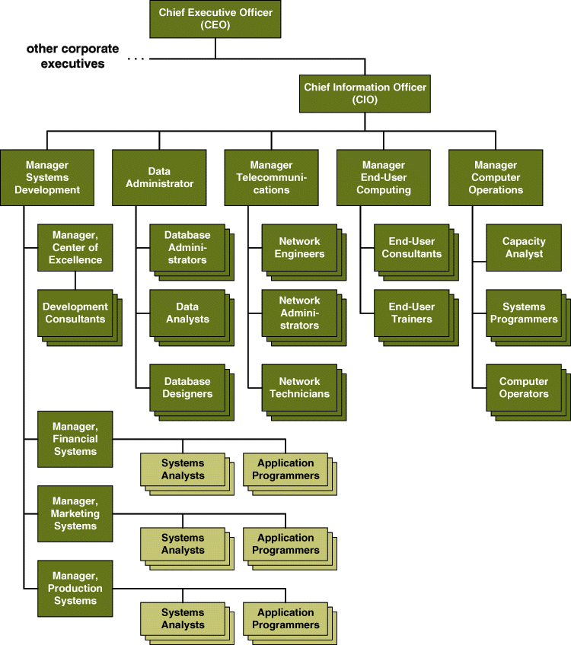
Traditional IS Services Organization
Notes:
Chapter 1 - Players in the Systems Game
Teaching Tips
The key characteristic of the traditional organization is the permanent assignment of analysts and programmers to a specific business function or area.
The figure shows only analysts and programmers assigned to one team, “manufacturing systems.” Space prevented us from showing that there would also be a team of analysts and programmers for each of the other functional areas: marketing and financial.

Slide 17
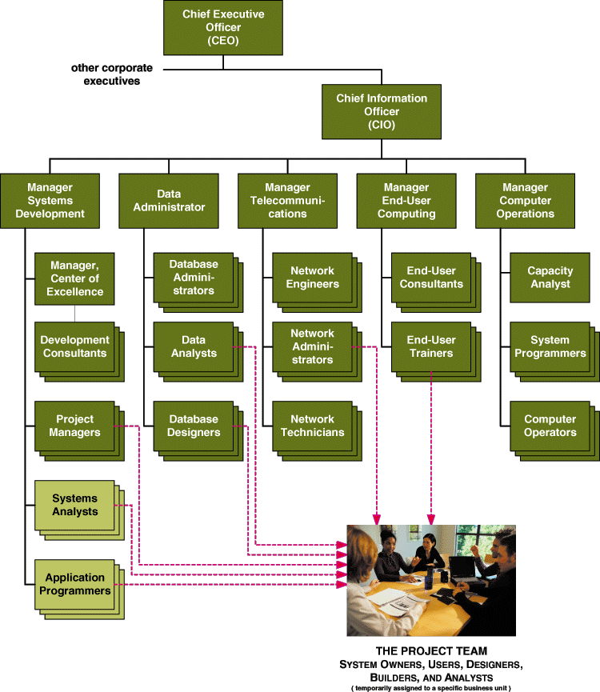
Contemporary IS Services Organization
Notes:
Chapter 1 - Players in the Systems Game
Conversion Notes
We tried to greatly simplify this figure from the previous edition. The key change was to note how analysts, programmers, and other specialists are “pooled” for dynamic and temporary assignments to project teams as needed.

Slide 18
Business Trends and Drivers
Total quality management (TQM)
Continuous process improvement (CPI)
Globalization of the economy
Information technology problems and opportunities
Enterprise resource planning (ERP)
Electronic commerce (EC or E-commerce)
Notes:
Chapter 1 - Players in the Systems Game
Conversion Notes
Introduced legacy-driven trends such as Y2K and the Euro.
Introduced new technology trends that are changing business processes and rules. Examples include ERP and E-commerce.
Teaching Notes
The Y2K problems should be mostly fixed by the time this edition is published, but some companies may still be working on lower-priority (nonmission-critical) applications. Also, some Y2K fixes were short-term fixes that may require a better long-term solution.

Slide 19
Business Trends and Drivers
Total quality management (TQM)
Continuous process improvement (CPI)
Globalization of the economy
Information technology problems and opportunities
Enterprise resource planning (ERP)
Electronic commerce (EC or E-commerce)
Notes:
Chapter 1 - Players in the Systems Game
Conversion Notes
Introduced legacy-driven trends such as Y2K and the Euro.
Introduced new technology trends that are changing business processes and rules. Examples include ERP and E-commerce.
Teaching Notes
The Y2K problems should be mostly fixed by the time this edition is published, but some companies may still be working on lower-priority (nonmission-critical) applications. Also, some Y2K fixes were short-term fixes that may require a better long-term solution.

Slide 20
Total Quality Management
Total quality management (TQM) is a comprehensive approach to facilitating quality improvements and management within a business.
Information systems quality standards:
ISO 9001, Quality systems – Model for quality assurance in design/development, production, installation, and servicing.
Capability Maturity Model (CMM) is a framework to assess the maturity level of an organization’s information systems development and management processes and products. It consists of five levels of maturity as measured by a set of guidelines called the key process areas.
Notes:
Chapter 1 - Players in the Systems Game
Teaching Notes
Weinberg: “If builders built buildings the same way that programmers wrote programs, the first woodpecker would destroy civilization.”
Many businesses are moving toward information systems quality certification based on one or both of the standards listed.
The federal government has mandated that future companies that seek supply software for government agencies and contracts must be CMM Level 3 or better. Many of these businesses have elected to achieve this CMM Level 3 certification for all information and software, not just government contracted products.
It is important to note that ISO 9001 and CMM seek to certify the process used to develop systems and software, not the systems and software for their own sake.

Slide 21
Business Process Redesign
Business process redesign (BPR) is the study, analysis, and redesign of fundamental business processes to reduce costs and/or improve value added to the business.
Usually complemented by continuous process improvement
Notes:
Chapter 1 - Players in the Systems Game
No additional notes

Slide 22
Continuous Process Improvement
Continuous process improvement (CPI) is the continuous monitoring of business processes to effect small but measurable improvements to cost reduction and value added.
Essentially the opposite of business process redesign; however,
CPI can and frequently does complement BPR.
Notes:
Chapter 1 - Players in the Systems Game
No additional notes

Slide 23
Legacy Systems
Legacy systems are older information system applications that have become crucial to the day-to-day operation of a business and that may use technologies considered old or outdated by current standards.
Can be replaced by alternative solutions:
ERP
E-Commerce
Notes:
Chapter 1 - Players in the Systems Game
No additional notes

Slide 24
Enterprise Resource Planning
An Enterprise resource planning (ERP) software product is a fully integrated information system that spans most basic business functions required by a major corporation. An ERP product is built around a common database shared these business functions. Examples of ERP software vendors include.
Oracle
Notes:
Chapter 1 - Players in the Systems Game
Teaching Notes
ERP is dramatically changing the role of the modern systems analyst. Instead of spending effort on requirements planning and systems design, ERP redirects effort to activities such as customization, business process redesign and alignment, and system implementation.
Systems analysts who work on ERP projects are almost always called systems integrators.

Slide 25
Electronic Commerce
Electronic commerce (e-commerce or EC) involves conducting both internal and external business over the Internet, intranets, and extranets.
Electronic commerce includes the buying and selling of goods and services, the transfer of funds, and the simplification of day-to-day business processes – all through digital communications.
Three basic types of electronic commerce applications include:
Marketing
Business-to-consumer (B2C)
Business-to-business (B2B)
Notes:
Chapter 1 - Players in the Systems Game
No additional notes

Slide 26
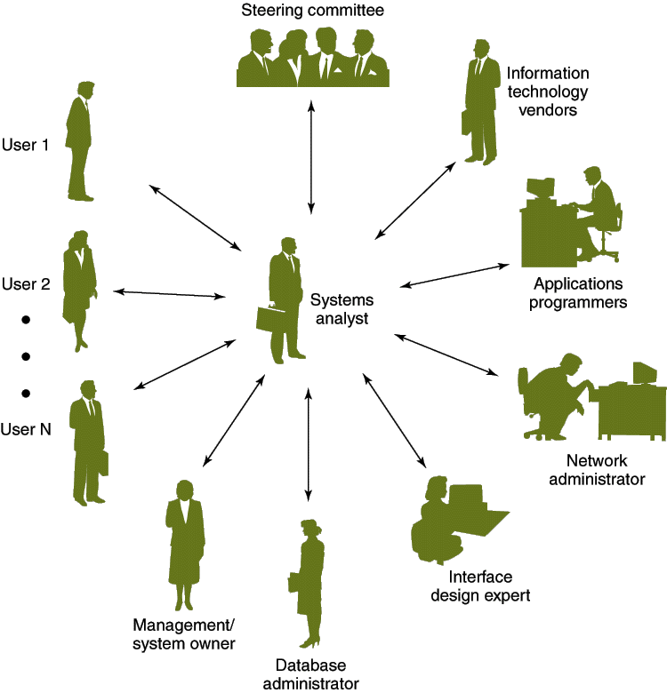
The Systems Analyst as a Facilitator
Notes:
Chapter 1 - Players in the Systems Game
No additional notes

Slide 27
Skills Required by Systems Analysts
Working knowledge of information technology
Computer programming experience and expertise
General business knowledge
Problem-solving skills
Interpersonal communication skills
Interpersonal relations skills
Flexibility and adaptability
Character and ethics
Systems analysis and design skills
Notes:
Chapter 1 - Players in the Systems Game
No additional notes

Slide 28
Computer Ethics
The Ten Commandments of Computer Ethics
1. Shall not use a computer to harm other people.
2. Shall not interfere with other people's computer work.
3. Shall not snoop around in other people's computer files.
4. Shall not use a computer to steal.
5. Shall not use a computer to bear false witness.
6. Shall not copy or use proprietary software for which you have not paid.
7. Shall not use other people's computer resources without authorization or proper compensation.
8. Shall not appropriate other people's intellectual output.
9. Shall think about the social consequences of the program you are writing or the system you are designing.
10. Shall always use a computer in ways that insure consideration and respect for your fellow human
Source: Computer Ethics Institute
Notes:
Chapter 1 - Players in the Systems Game
Conversion Notes
This slide was brought forward from Module B of the 4th edition.
Teaching Tips
See the suggested readings for a book of ethics scenarios that could be introduced, tested, and analyzed as part of a lecture on computer ethics.
We have always considered it important to emphasize that a person’s ethical integrity is “earned.” More significantly, if that ethical integrity is in any way compromised, it is difficult to repair the image.

Slide 29
Thank You

